Slide 1

Revolutionizing Penetration Testing
Caleb Hall, Calla Robison, Michael Allen, Myles Scott, Joshua Buscher

Slide 2
Team Introduction
Joshua Buscher – Documentation Specialist
Calla Robison – Web Developer
Caleb Hall – Scrum Master and Pentester
Michael Allen – Project Planner and Pentester
Myles Scott – Web Developer and Documentation

Slide 3
Overview
Mission Statement: Empowering Organization Cybersecurity through the democratization of vulnerability testing
Vision: A Safer Digital World through more accessible Security
Core Values: Accessibility, Reliability, User-Centric Design
End Goal: Distribute an online method for companies to easily test their own website vulnerabilities

Slide 4
Ending Last Semester
Burp Suite API
Detailed requirements and design
Website home page and deployment base

Slide 5
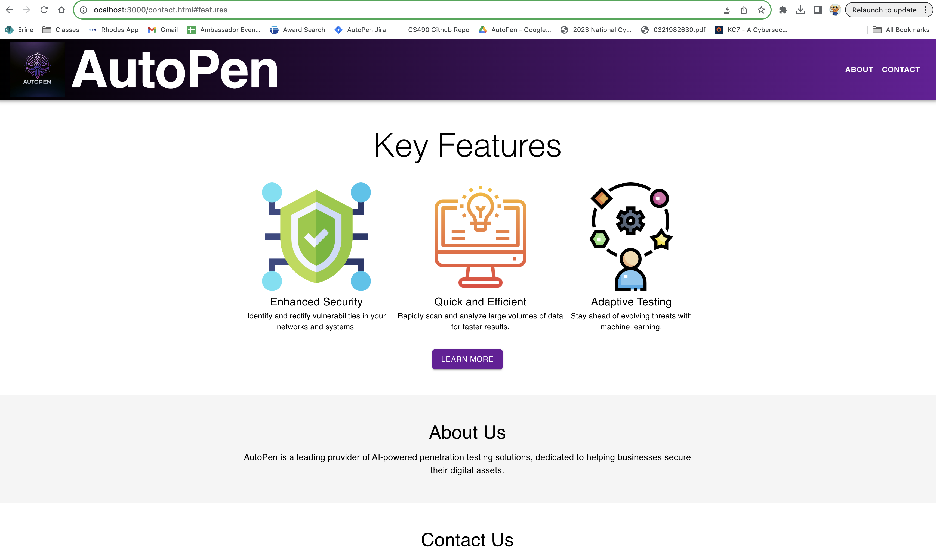
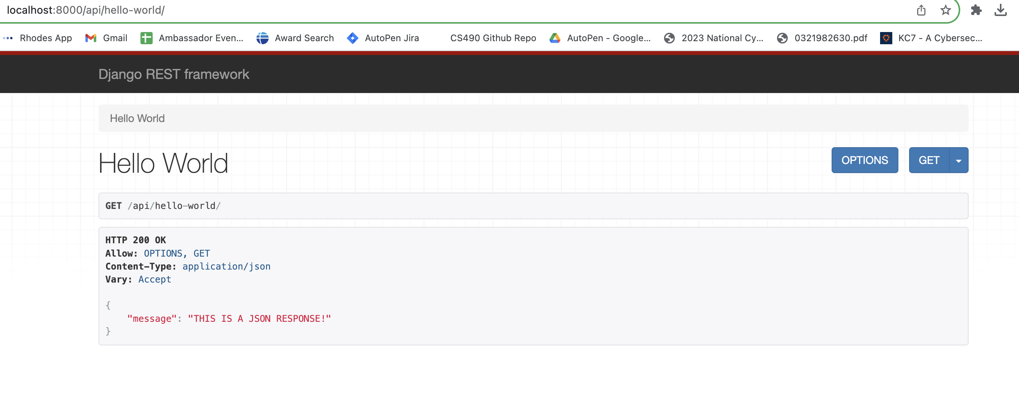

Slide 6
Changes Made
No AI
System communication configured
Physical hardware middle-man

Slide 7
The Inner Workings of AutoPen
Step-by-Step Process:
User Registration
Setting Up a Test
Test Execution
Data Analysis
Result Presentation
Backend Mechanics:
Burp Suite API
Cloud-Based Operations
Continuous Updates
Data Analysis
Step-by-step process outlines a user-friendly approach to conducting thorough web application penetration tests.
Backend mechanics emphasize Autopen's innovative approach to lowering barriers of entry, providing a simple avenue to online cybersecurity and asset protection.

Slide 8
AutoPen Demo

Slide 9
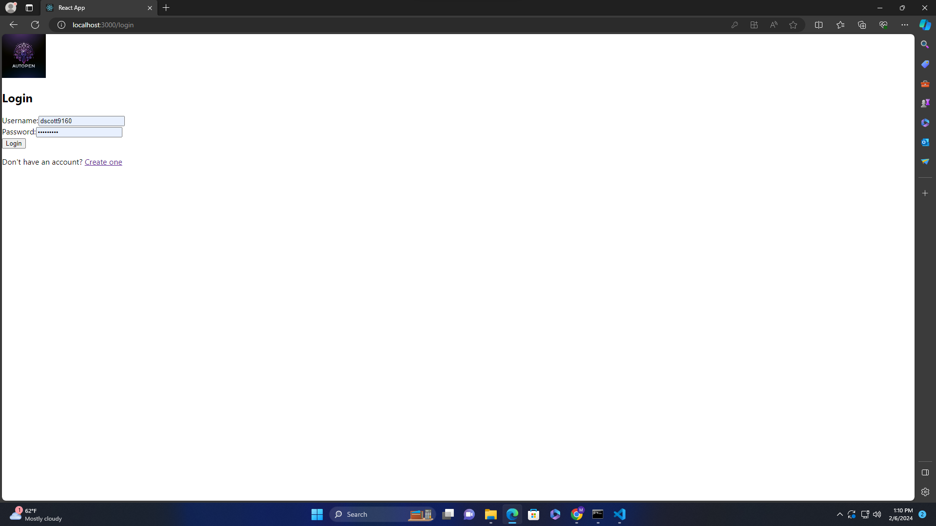
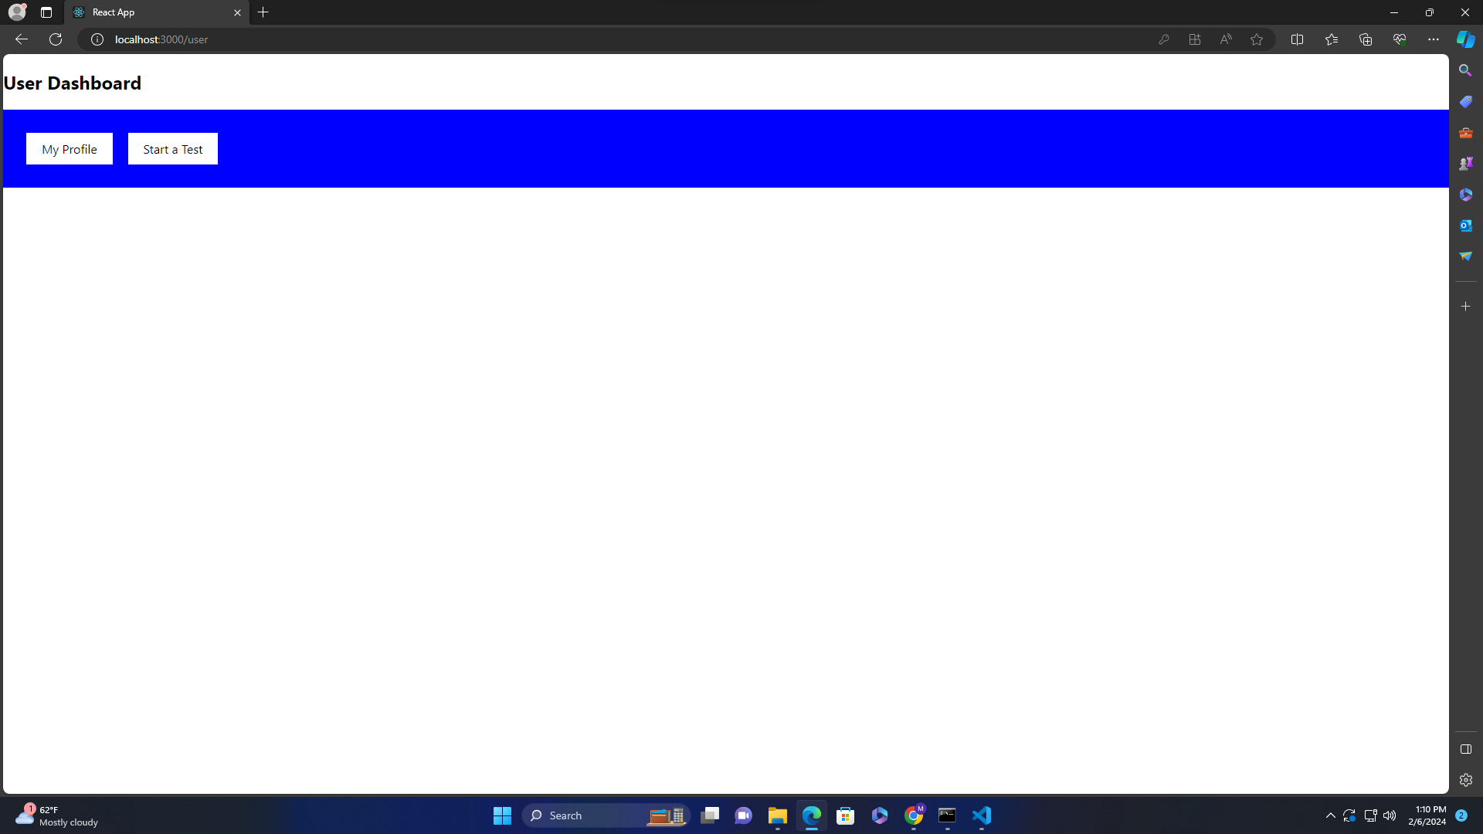


Slide 10
Work Remaining
Additional Web Functionality
(SPRINT 2 Goal)
Migrate to Droplets for Final Product Demonstration
Visualization of vulnerability data

Slide 11
Limitations & Challenges
Current Limitations:
Time Constraints ( 2.5 MONTHS!!)
VM Hosting
Financial
Challenges:
Legal and Ethical Considerations
Technology Integration

Slide 12
Future Goals
Droplet alternative
Cleaner integration
Custom Scan Code
Find a way to do cloud services without droplets, or find funding to use them
Improved integration of back-end algorithms to front-end web service
Expand past the pre-built Burp Suite tools

Slide 13

Questions & Answers

